Slide 1
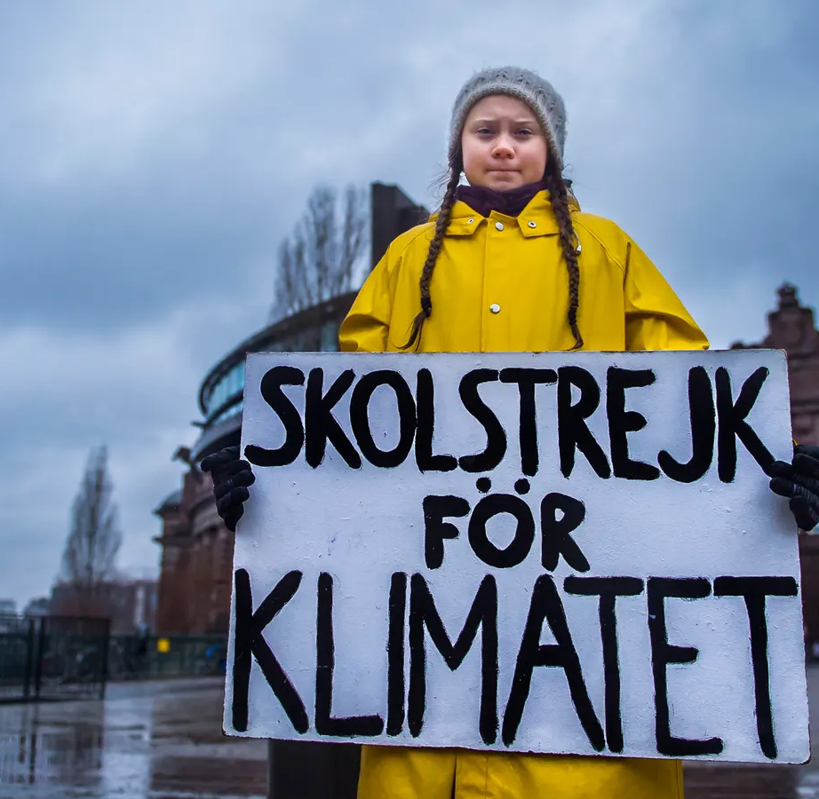
What do you think is happening here?
This is a picture of Greta Thunberg who decided to strike from school on Fridays in protest at how climate change was being ignored by world leaders.
Here, she is pictured outside of the Parliament in Sweden, the country where she is from.

Slide 2
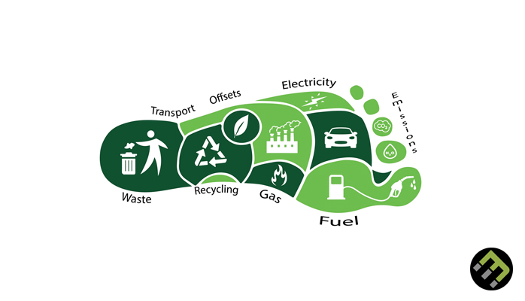
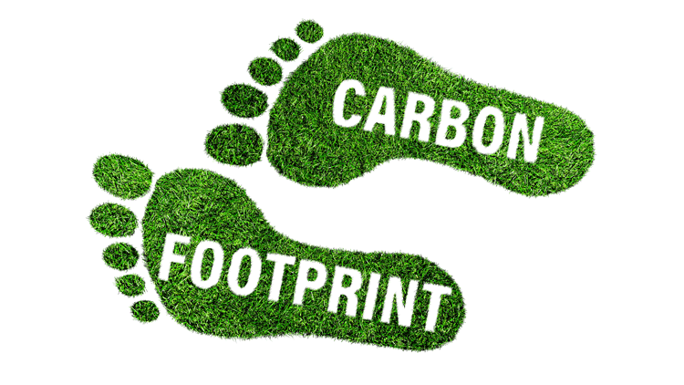
Do now activity…
What does “carbon footprint” mean?
What are some of the ways that we can reduce our carbon footprint?
A carbon footprint is the total amount of greenhouse gases (including carbon dioxide and methane) that are generated by our actions.
Switch to plant based milk.
Reduce meat consumption.
Buy less clothes.
Eat chocolate from sustainable manufacturers.
Avoid/reduce flying on a plane.
Waste less food.
Don’t waste energy at home e.g. lighting and heating.
Recycle more items –even difficult ones!
Buy less toys/things.
Take shorter showers.

Slide 3
Climate Change Lesson 5: Unity and inspiring people.
Learning Intention: To learn about inspirational things people have done.
Success criteria 1: To look at Greta Thunberg and why she is famous.
Success criteria 2: To look at how some people around the world have fought climate change and protected their local environment.
Success criteria 3: To reflect by completing a paragraph on inspirational people.

Slide 4
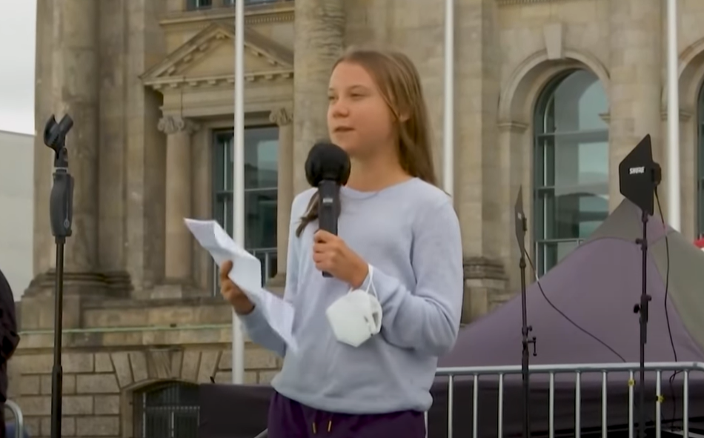
Success criteria 1: To look at Greta Thunberg and why she is famous.
On 20 August 2018, the Swedish climate activist Greta Thunberg, then in ninth grade, decided to not attend school until the 2018 Sweden general election on 9 September after heat waves and wildfires in Sweden. She has said she was inspired by the teen activists at Marjory Stoneman Douglas High School in Parkland, Florida, who organised the March for Our Lives. Thunberg protested by sitting outside the Riksdag every day during school hours with a sign that read "Skolstrejk för klimatet" ("school strike for climate").
Among her demands were that the Swedish government reduce carbon emissions per the Paris Agreement. On 7 September, just before the general elections, she announced that she would continue to strike every Friday until Sweden aligns with the Paris Agreement. She coined the slogan Fridays For Future, which gained worldwide attention, and inspired school students across the globe to take part in student strikes.
Now watch the video on Greta Thunberg.
https://www.youtube.com/watch?v=CzH6vyN2_uw

Slide 5
Success criteria 1: To look at Greta Thunberg and why she is famous.
Answer the following questions in full sentences:
What was Greta Thunberg unhappy about?
What did she do to make her voice heard?
What did she want to happen?
How likely was it that the politicians would listen to her?
What has the result of her actions been?
Challenge:
Do you think Greta was right to strike from school?

Slide 6
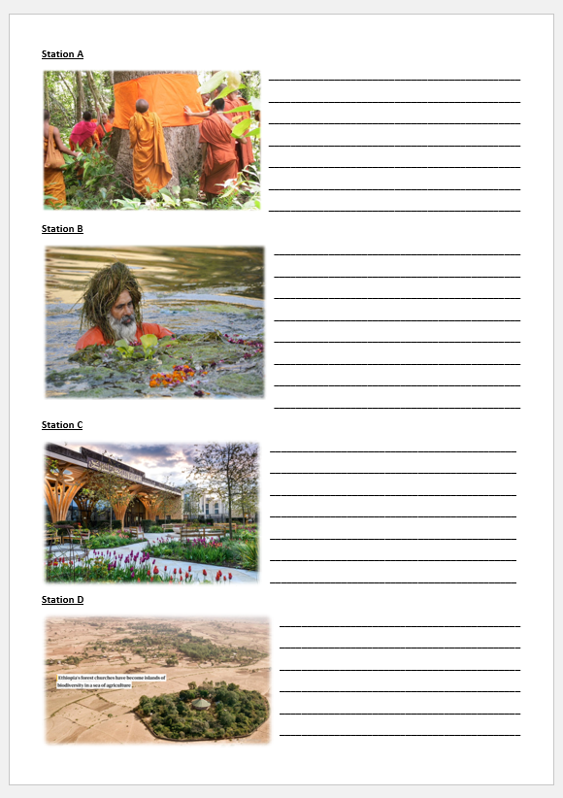
Success criteria 2: To look at how some people around the world have fought climate change.
Your task now is to move around the room and collect information from each of the stations.
As you move around, fill in your sheet.

Slide 7
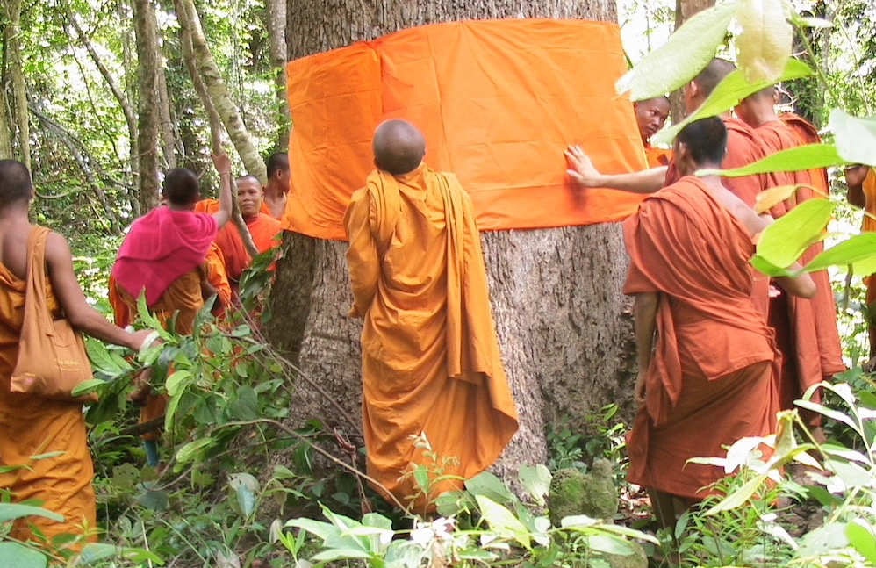
Success criteria 2: To look at how some people around the world have fought climate change.
Station A
Buddhists ordain trees as monks to save forests.
The Monks Community Forest is 18,300 hectares (about 183 sq km) of legally-protected evergreen forest in Cambodia.
It owes its protected status to a group of Buddhist monks, who, inspired by the teachings of the Buddha, set out to safeguard the area in the early 2000s by ordaining trees as monks.
Buddhism plays a very important role in conserving nature, says Bun Saluth: 'When Lord Buddha was alive, he used trees and caves as his lodging to achieve enlightenment. In this way he taught us to love nature and animals.’
Patrolling and awareness-raising activities have significantly reduced incidents of forest crime including logging, hunting and land clearing, and is helping to safeguard the area’s biodiversity.
Notes:
https://www.faithplans.org/post/buddhists-ordain-trees-as-monks-to-save-forests

Slide 8
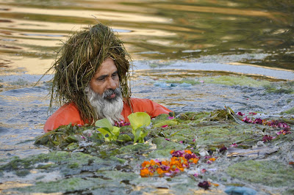
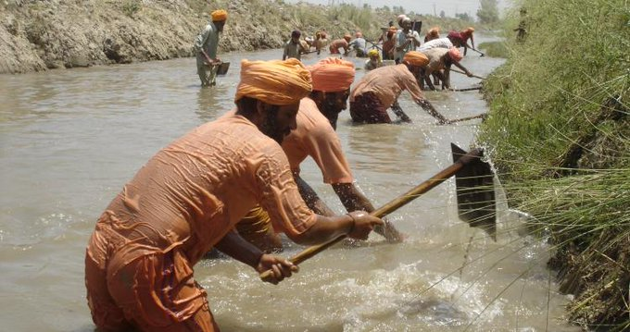
Success criteria 2: To look at how some people around the world have fought climate change.
Station B
Balbir Singh Seechewal is one of the most renowned environmentalists from Punjab who is also known as “Eco Baba”.
In 2000, Balbir Singh decided that something had to be done about the domestic and industrial waste that was killing the Kali Bein river – 160 km long tributary of Beas in Doaba region of Punjab. The river, which is considered sacred by many in the state, had reduced to nothing but a drain because of all the waste that was being discarded in it. Some portions of the river had even dried up, resulting in immense water problems in the neighbouring farms.
He started the work and encouraged volunteers from the local area to help. Once the project gained attention, he also started to educate people on the dangers of polluting the river.
Notes:
https://www.thebetterindia.com/51513/balbir-singh-seechewal-punjab-river-cleaning/
https://www.seechewaltimes.com/2018/08/eco-baba-man-who-cleaned-60-km-long.html

Slide 9
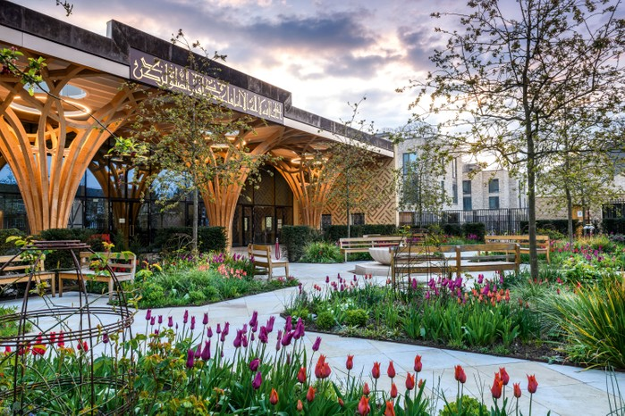
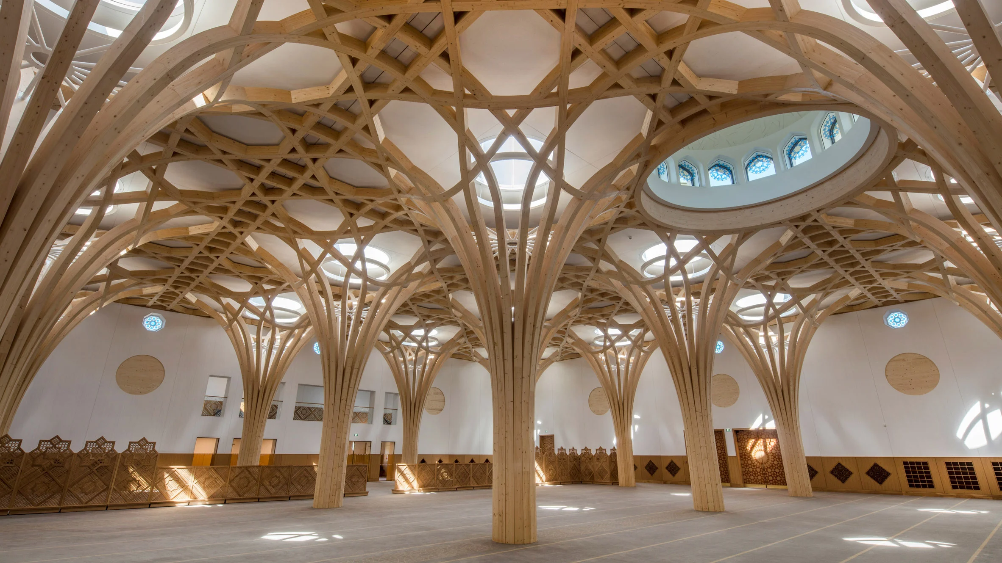
Success criteria 2: To look at how some people around the world have fought climate change.
Station C
Cambridge Central Mosque
Europe’s first eco-friendly mosque
Muslims feel a strong imperative to protect the environment, as it is a gift from the Divine. This mosque is committed to sustainability: its advanced eco-design gives it a near-zero carbon footprint, honours natural forms with sustainable timber vaulting, and reminds the visitor of our connection to nature.
Features include:
-Natural lighting from roof skylights, helped by low energy LEDs when needed.
-Solar panels on the roof to generate electricity.
-Heat pumps to generate heat – this doesn’t use gas, but electricity instead.
-Lots of insulation to keep heat in.
-Rainwater is collected to flush toilets and water the garden.
-Lots of spaces for bicycles to be stored for worshippers as well as the mosque being accessible by foot and public transport.
Notes:
https://cambridgecentralmosque.org/environment/

Slide 10
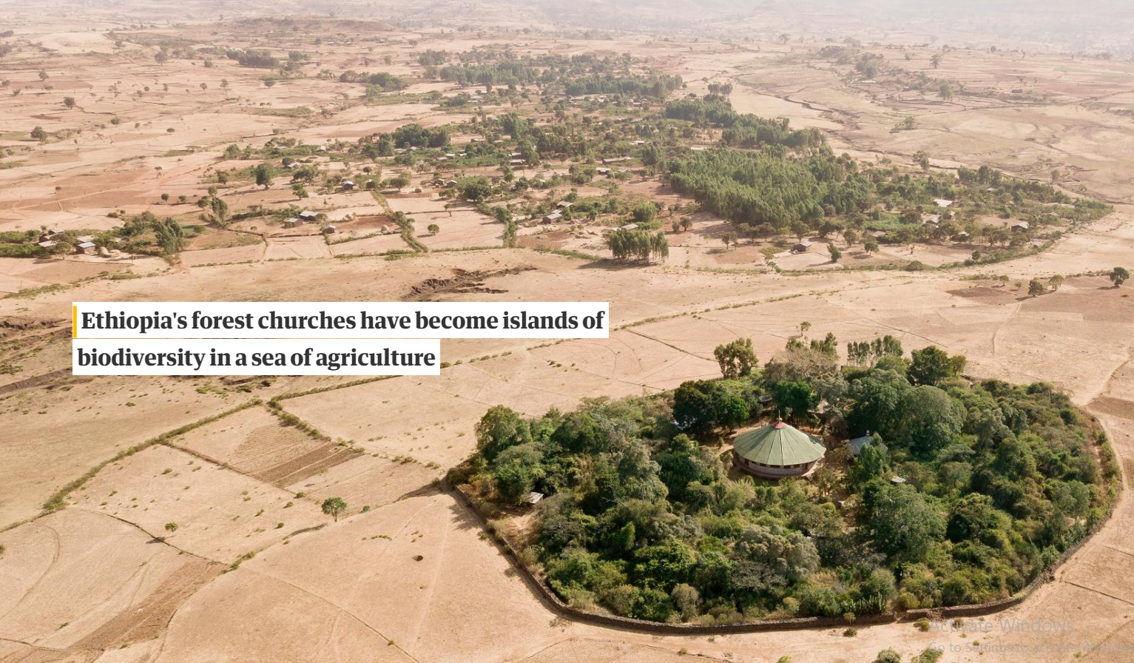
Success criteria 2: To look at how some people around the world have fought climate change.
Station D
Ethiopian Church Forests
In the early 1900s, it’s estimated that trees covered roughly 40 percent of Ethiopia. But over the past century, as populations grew, the demand for food skyrocketed. Acres of forests were replaced by agricultural fields. It now hovers at just around 4 percent of the country.
Alemayehu Wassie Eshete grew up attending Ethiopian churches surrounded by forests and said “You go from dry, hot fields into the beautiful forest. Anyone would see that as beautiful, but for me, the forest is more than that. It’s also a spiritual place where nature is perfect, and you pray to God.”
He now works with priests and local communities to preserve the remaining church forests. The most efficient, straightforward thing they could do to preserve the forests, the scientists decided with the priests, was to build low, simple walls that would carefully demarcate the forests and keep wandering animals from lumbering in. Thye’re so successful locals are now even expanding the walls and slowly growing the forests.
Photograph: Kieran Dodds
Notes:
Gardens of Eden: the church forests of Ethiopia – a photo essay | Ethiopia | The Guardian
See the incredible “church forests” of Ethiopia (nationalgeographic.com)

Slide 11
Success criteria 3: To reflect by completing a paragraph on inspirational people.
Greta Thunberg is a Swedish environmental ______who is known for challenging world leaders to take immediate action for climate change mitigation. In August 2018, at age 15, she started spending her ______ outside the Swedish Parliament to call for stronger action on climate change by holding up a sign reading “Skolstrejk för klimatet” (School strike for climate).
There are also religious individuals and groups across the world who are taking action to protect their local ______ and the global climate. In ________, monks have ordained trees as monks to reduce logging and deforestation. In the _________, “Eco Baba” and volunteers have cleared 160km of a polluted river. In Cambridge, Europe’s first eco-friendly mosque has been built, with solar panels, great insulation and a system to collect and use ______ in a useful way. In Ethiopia, local priests and communities are preserving what remains of the forests in what are called church forests.
The climate crisis will impact ______ on the planet. However, there are people who are trying their best to make positive changes to reduce their ________ and save local environments.
Key Words
everyone
Cambodia
Punjab
rainwater
environment
Activist
Fridays
carbon footprint

Slide 12
Success criteria 3: To reflect by completing a paragraph on inspirational people.
Greta Thunberg is a Swedish environmental activist who is known for challenging world leaders to take immediate action for climate change mitigation. In August 2018, at age 15, she started spending her Fridays outside the Swedish Parliament to call for stronger action on climate change by holding up a sign reading “Skolstrejk för klimatet” (School strike for climate).
There are also religious individuals and groups across the world who are taking action to protect their local environment and the global climate. In Cambodia, monks have ordained trees as monks to reduce logging and deforestation. In the Punjab, “Eco Baba” and volunteers have cleared 160km of a polluted river. In Cambridge, Europe’s first eco-friendly mosque has been built, with solar panels, great insulation and a system to collect and use rainwater in a useful way. In Ethiopia, local priests and communities are preserving what remains of the forests in what are called church forests.
The climate crisis will impact everyone on the planet. However, there are people who are trying their best to make positive changes to reduce their carbon footprint and save local environments.
Key Words
everyone
Cambodia
Punjab
rainwater
environment
Activist
Fridays
carbon footprint

Slide 13
To finish, a quick quiz.
If you get a trophy, you can leave first if you get the next question right…

Slide 14




Spin the Wheel
3
2
1st
1
SPIN
4
1st
5
6
Notes:
Name the Swedish activist who went on school strike? –Greta Thunberg.
Which country has church forests? –Ethiopia.
Where is Europe’s first eco-friendly mosque? –Cambridge.
What’s the nickname of the Sikh who cleaned 160km of river in the Punjab? –”Eco Baba”.
In which country do monks ordain trees as monks to stop them being chopped down? –Cambodia.
Give me a key word and it’s definition from this topic.

